Slide 1

Who Am I?
You're More Beautiful Than You Think
Two-part lesson
Human Relations, Diversity & Equity
Student Support and Attendance Services
Notes:
Teacher, please feel free to encourage student participation whichever way you are most comfortable: in the Zoom chat, on a previously shared Jamboard, in break out groups, or all together in a grid view.

Slide 2
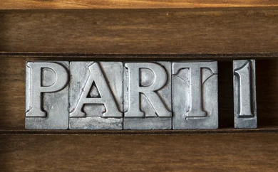
Notes:
Two-part lesson on body images, with videos for boys and girls.

Slide 3

Would you rather...
A) live alone with no one else around
OR
B) live in a house with 1 bathroom for 10 people

Slide 4
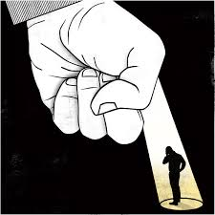
We are often our own worst critic
We often say that we are our own worst critic
This means that we often see ourselves much more critically than others see us
We are often much harder on ourselves than others are
These messages may come from many sources
  Society that creates images of what "beauty" is
  Through magazines, movies, tv shows, and each other
  If we don't look or act the way society says we should, we judge ourselves and compare
Notes:
Script:

Slide 5
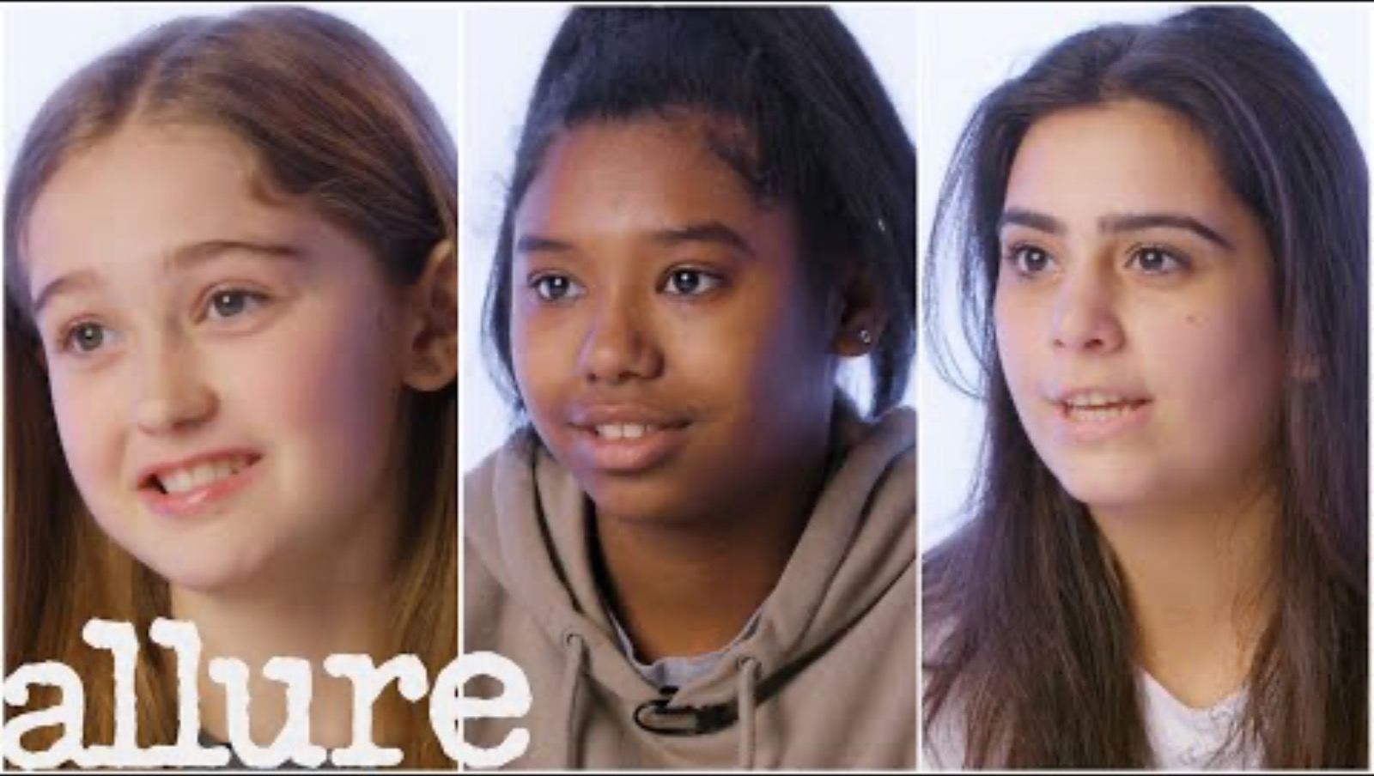
Body Image
Notes:
https://www.youtube.com/watch?v=5mP5RveA_tk

Slide 6
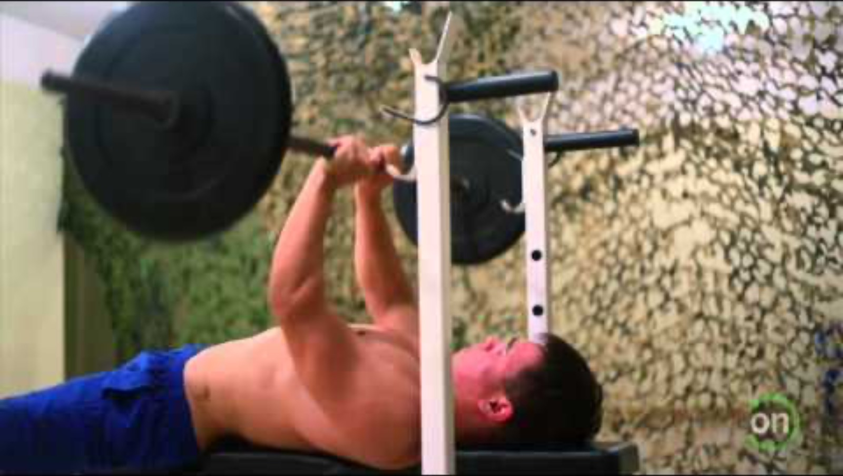
Boys & Body Image
Notes:
https://www.youtube.com/watch?v=LiY8WSzY_xQ

Slide 7

Do you ever feel like you are being judged by how you look?
Have you ever had a similar experience as the people in these videos?
Notes:
Teacher
Use the platform you are comfortable with (chat, whiteboard, jamboard, etc) for students to respond and discuss a couple of them.

Slide 8
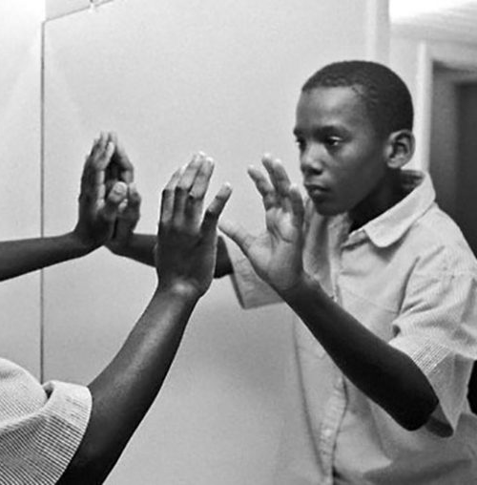
Homework
Look at yourself in the mirror for a full minute
Say something nice to your reflection

Slide 9

Checkout
Write a positive attribute that begins with the same letter as your name.
e.g..,
Joyful Jose
Awesome Alicia

Slide 10


Slide 11
Objectives
Reflect on how media images can warp our image of ourselves.
Explore the concept of “being one’s worst enemy.”
Discuss strategies for positive self-esteem.

Slide 12
Write a positive attribute that begins with the same letter as your name.
e.g..,
Joyful Jose
Awesome Alicia

Slide 13
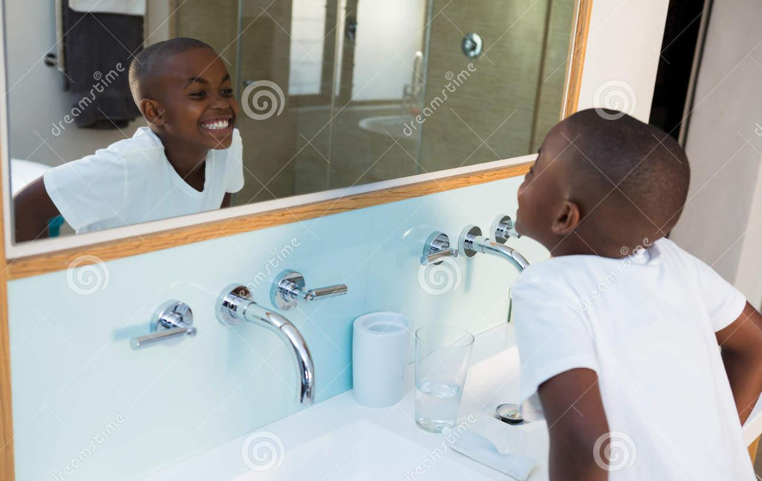
Reflections
Your homework last session was to look at yourself in the mirror for one full minute and to say something nice to yourself.
Hold up the number of fingers for how silly or awkward that felt – all 5 fingers very silly; 0 fingers (a closed hand) not silly at all.

Slide 14
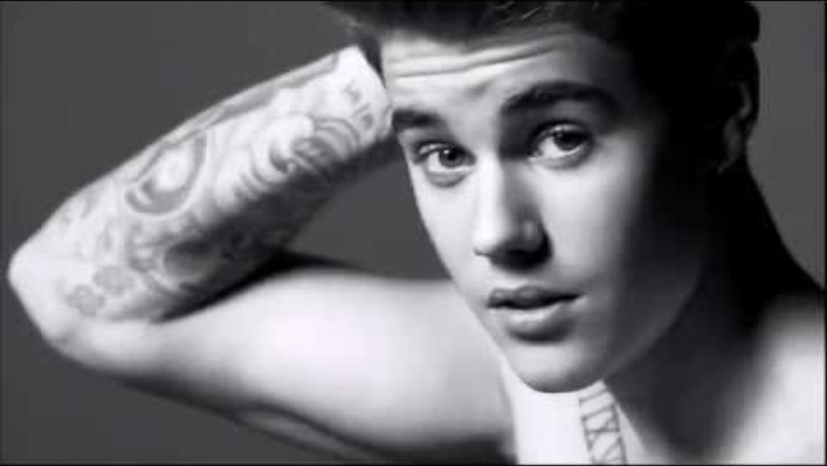
What messages do men hear?
Notes:
https://www.youtube.com/watch?v=KF7OtqvIsV8

Slide 15
What did you think about the video?
Do you think this is an accurate depiction of how we see ourselves vs. How others see us?
What is your favorite thing about your body?
Notes:
Teacher
Use the platform you are comfortable with (chat, whiteboard, jamboard, etc) for students to respond and discuss a couple of them.

Slide 16
What can you do to empower yourself and others?
Find something good about everyone you encounter
Compliment others, even if you don't know them
Stop yourself when you are judging someone.
Be kind to yourself
Look in the mirror every day and tell yourself you are amazing!
Surround yourself with people who lift you up and support you

Slide 17
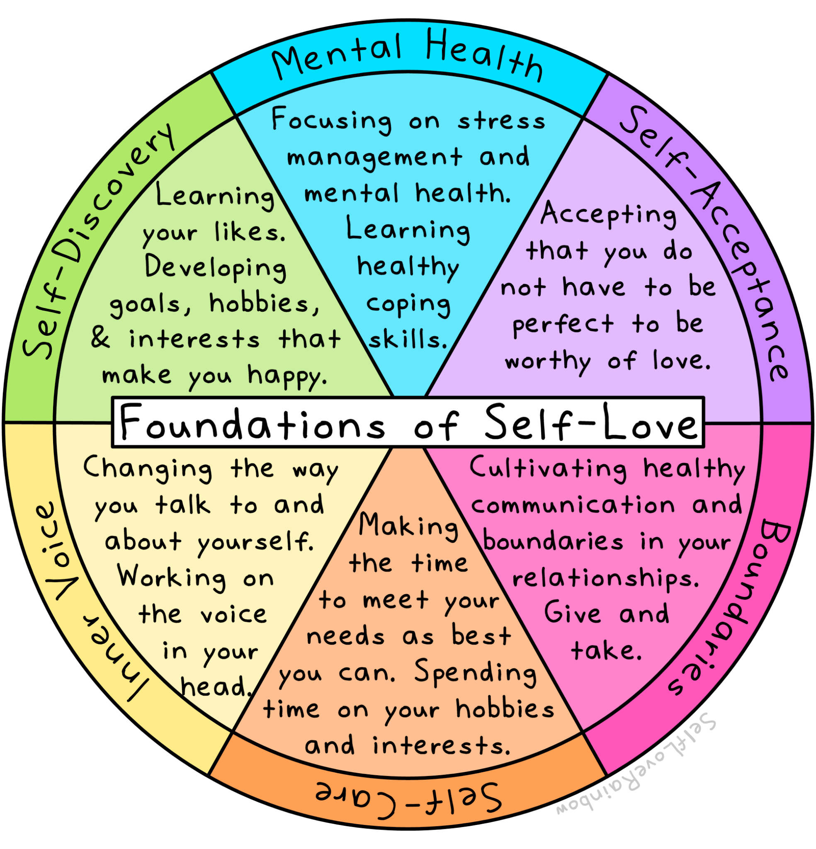
Check Out:
What is one way you can show yourself more love?
Notes:
Ask each student to write something they like about themself. It can be private; they don't need to share it with anyone.

Slide 18


Slide 19
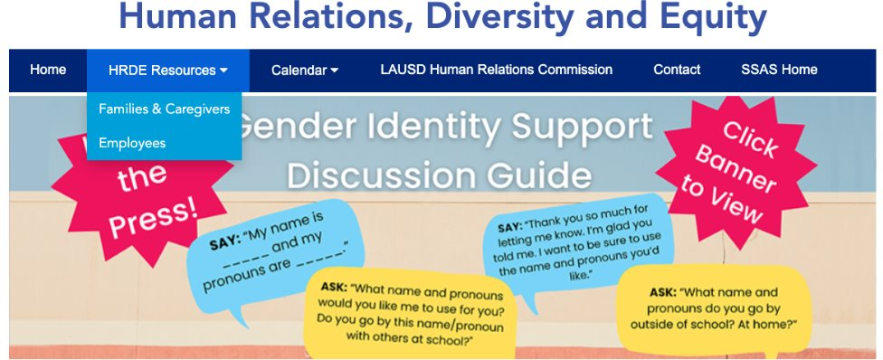
For additional resources, visit us at: https://www.lausd.org/human-relations

